Slide 1


Slide 2
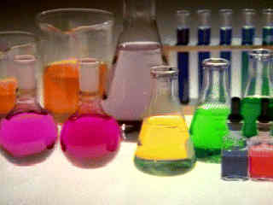
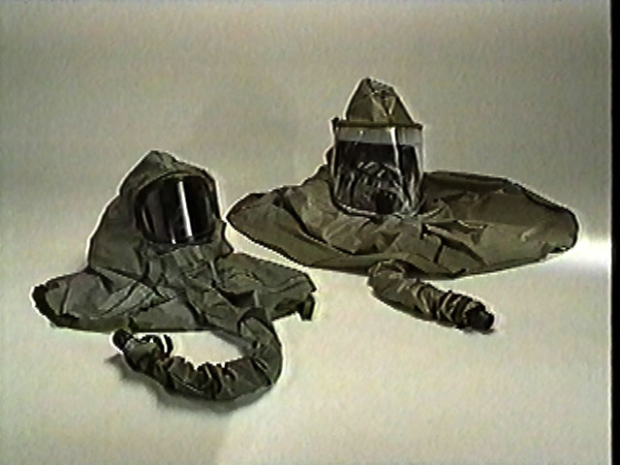
Management of Acute Organophosphorous Nerve Agents Poisoning
Mahdi Balali-Mood¹
Mohammad Moshiri² , Leila Etemad²
¹. Medical Toxicology Research Center, Medical School, Mashhad University of Medical Sciences, Mashhad, Iran
² Toxicology & Pharmacodynamy department, School of Pharmacy, Mashhad University of Medical Sciences, Mashhad, Iran

Slide 3
Overview
Nerve agents are organophosphate compounds, similar to organophosphate pesticides, but a group (lethal agents) of chemical warfare agents
These are the deadliest of CWA’s
These agents have both chemical names as well as 2-letter NATO codes.
G series agents: representing
“Germany”
GA (Tabun)
GB (Sarin)
GD (Soman)
GF
V Series agents: denoting “Venomous”.
VE
VG
VM
VX

Slide 4

History
The earliest recorded use of cholinesterase inhibitors was by native tribesmen of Western Africa
They used Calabar bean as an “ordeal poison” in witchcraft. An extract of Calabar bean was later used for various medicinal purposes and the active principle “physostigmine” was isolated in 1864
Notes:
A poison given to the accused to determine guilt or innocence. Like a witch trial, the idea behind the ordeal poison was that the guilty would die and the innocent would live when dosed.
I had always thought that ordeal poisons were another example of superstition and dubious science until I ran across a webpage which said explained how the Calabar Bean (Physostigma venosum) was used as an ordeal poison in (what is now) Nigeria:

Slide 5
History
Wurtz in 1854 synthesized the first organophosphate compound, tetraethyl pyrophosphate (TEPP)
In 1937 Gerhard Schrader developed the general formula for all organophosphorus compounds and manufactured GB and GA.

Slide 6
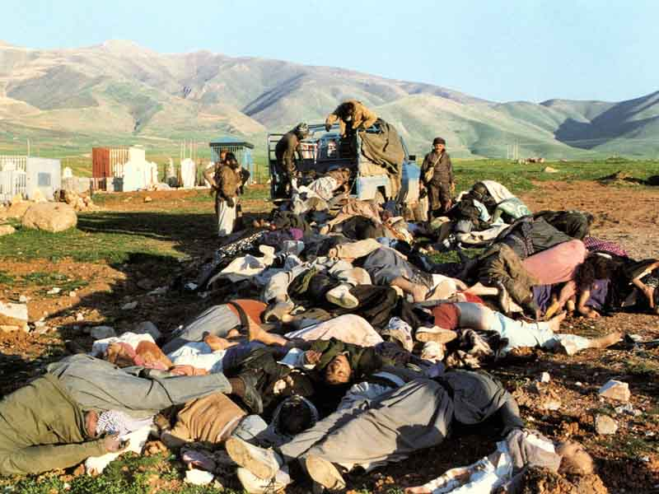
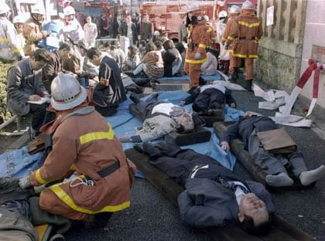
History
The nerve agents GA and GB were first used on the battlefield by Iraq against Iran during the first Persian Gulf war and again against the Kurdish
In 1995, the Japanese cult Aum Shinrikyo used GB in terrorist attacks in Tokyo resulting in 12 deaths

Slide 7
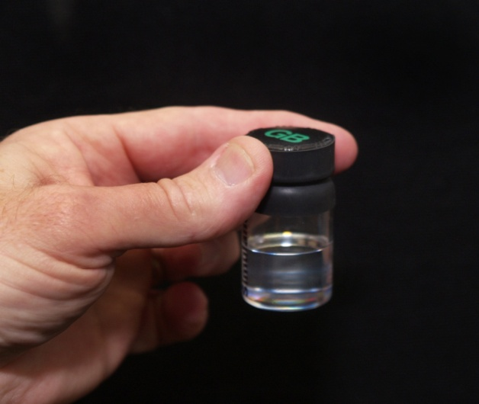
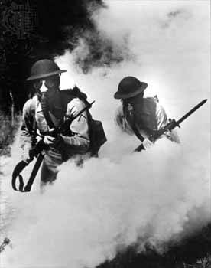
Properties
All nerve agents are liquid at standard temperature and pressure.
Nerve agents are four to six times denser than air.
GB
As a result, they tend to remain close to the ground and pose a risk particularly to the people in low areas and below ground shelters.
Notes:
They are soluble in water as well as organic solvents and fat. After contact with water, they are hydrolyzed to products that are less toxic than the parent compounds

Slide 8
Properties
They disperse within several hours and are described as non-persistent agents
The vapor pressure of the three G-agents (GA, GB and GD) makes them significant inhalation hazards, especially at warmer temperatures or when droplets are created by explosion or spray.
The G agents also represent a skin contact hazard, particularly when evaporation is minimized and contact is prolonged by contamination of clothing
Notes:
They are soluble in water as well as organic solvents and fat. After contact with water, they are hydrolyzed to products that are less toxic than the parent compounds
Based on information from animal studies, the lethal inhaled dose of G agents in humans may be about 1mg.

Slide 9
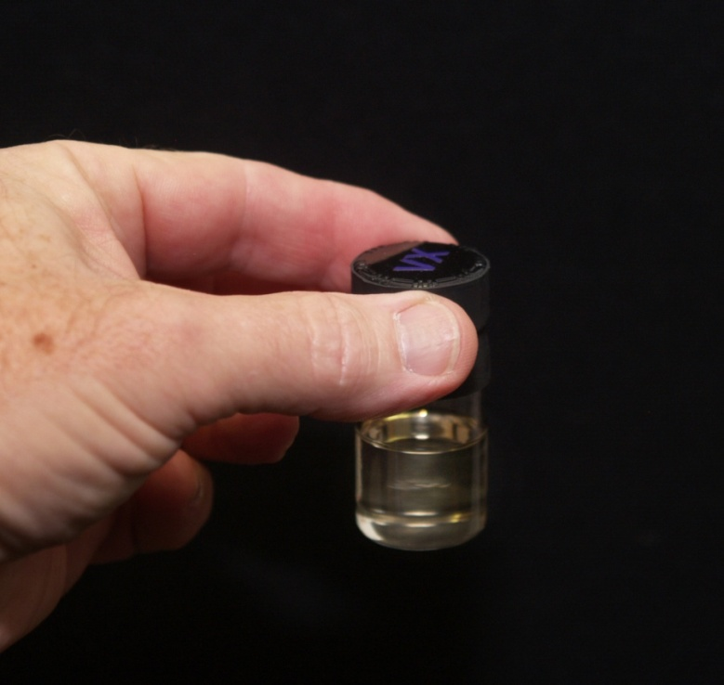
Properties
VX spreads slowly and remains in the place for weeks or longer after exposure and thus called a persistent nerve agent.
VX does not pose a major inhalation hazard under usual circumstances, but it is well absorbed through the skin
VX

Slide 10
Properties
The relative lethality as determined in animal studies is
VX > Soman > Sarin > Tabun

Slide 11
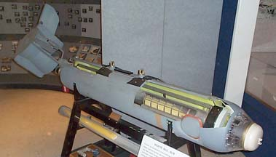
Properties
Delivery systems of nerve agents are bombs, missiles, cluster spray and spray tanks.
BLU-80/B Bigeye binary chemical munition dispenser would have carried 180 pounds of VX nerve agent

Slide 12
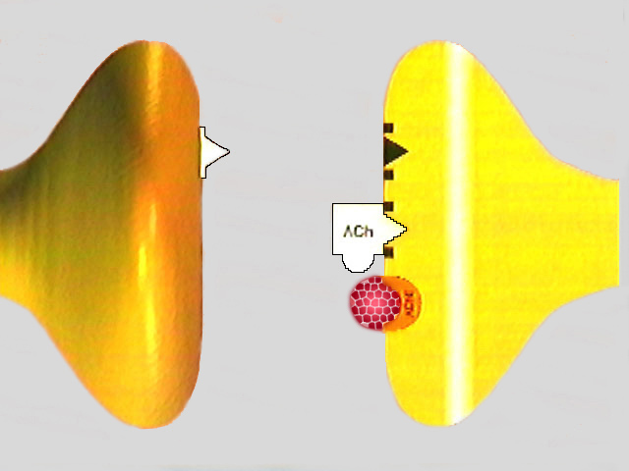
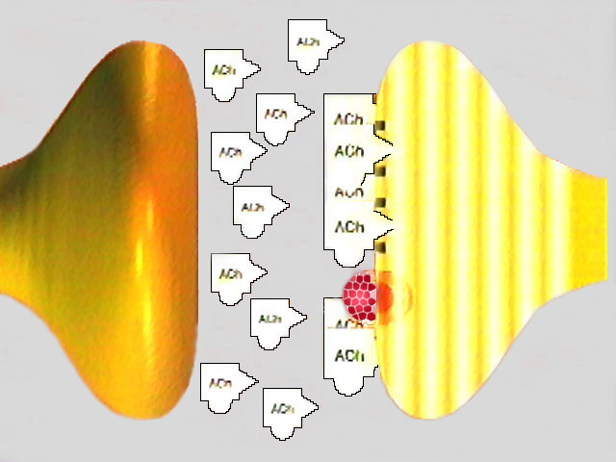
Mechanism of human toxicity
These agents act by binding to a serine residue at the active site of a acetylcholinesterase, thus forming a phosphorylating protein that is inactive and incapable of breaking down acetylcholine
End-organ overstimulation
Notes:
In addition VX can induce acute lung injury

Slide 13
Mechanism of human toxicity
Name | Synonym | Aging T1/2
Sarin | GB | ~5 hours
Soman | GD | ~2 min
Tabun | GA | >40 hours
VX | None | >40 hours
Notes:
The rate of aging varies greatly among the nerve agents. The half-time of aging is within minutes after soman exposure, about five hours after sarin exposure and >40 hours after exposure to tabun and VX

Slide 14
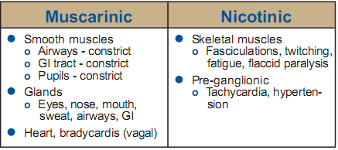
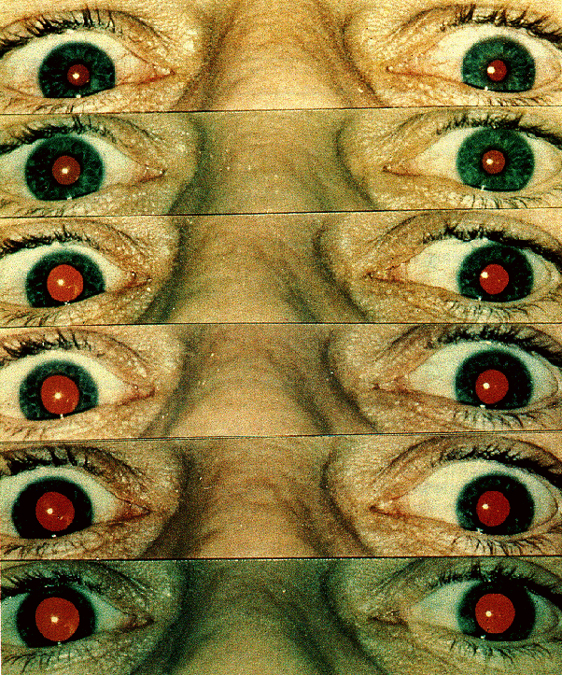
Clinical features
the world going black
“The patient drowning in his own secretions.”
Notes:
Muscarinic effects of acetyl choline stimulation include: miosis, blurred vision, eye pain, hypersecretion by salivary, sweat, lachrymal and bronchial glands, bronchoconstriction, cough, cyanosis, pulmonary edema, nausea, vomiting, diarrhea, crampy abdominal pains, tenesmus, urinary and fecal incontinence, hypotension and bradycardia.
Nicotinic effects include easy fatigue, weakness, muscle cramp, fasiculations, skeletal muscle twitching, convulsions and flaccid paralysis. Nicotinic stimulation also can obscure muscarinic parasympathetic effects and produce mydriasis, tachycardia and hypertension by stimulation of the adrenal medulla

Slide 15
Central nervous system effects irritability, nervousness, ataxia fatigue generalized weakness depression of respiratory and circulatory centers with dyspnea, cyanosis, hypoventilation and hypotension impairment of memory confusion convulsions coma and respiratory depression
Clinical features

Slide 16
Clinical features
Death is due to respiratory failure due to a combination of
Bronchorrhea
Bronchospasm
Respiratory muscle paralysis
Central apnea.

Slide 17
Clinical features
Neuropsychiatric sequelae in non-dose dependant fashion have been described
This syndrome overlaps with post-traumatic stress disorder (PTSD) and in some patients it may actually be a true PTSD

Slide 18
Clinical features
Other delayed manifestations that have been observed include
Organophosphorus induced neuropathy (not seen with VX)
Intermediate syndrome
It is characterized by :
muscular weakness and occurs after apparent recovery from the acute cholinergic syndrome and reflects prolonged action of acetylcholine on nicotinic receptors.
Delayed neurobehavioural syndrome has been described in a small proportion of nerve agent survivors.

Slide 19
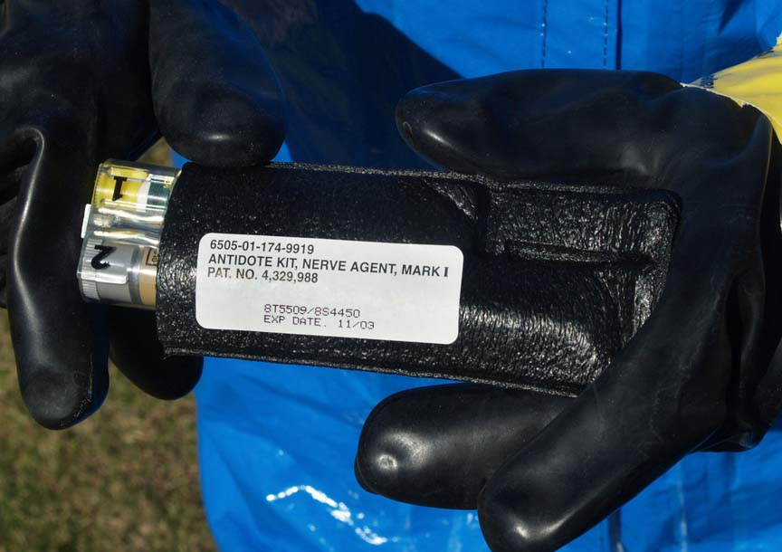
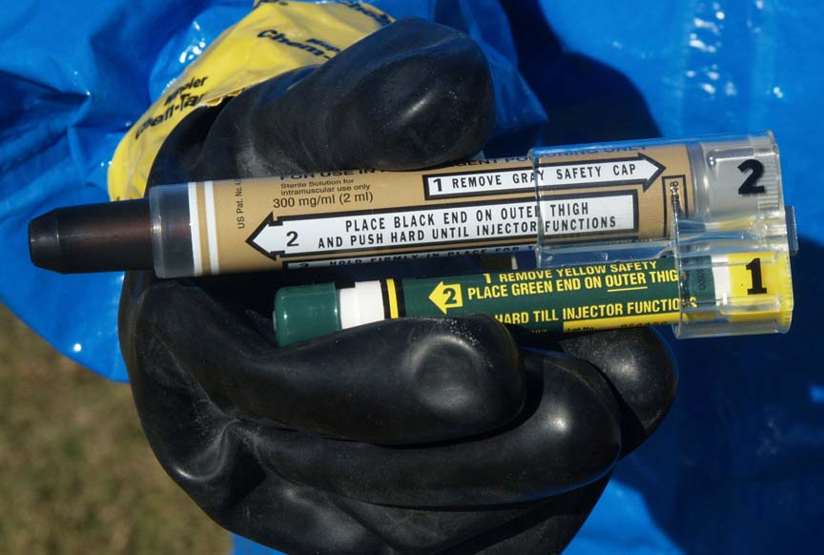
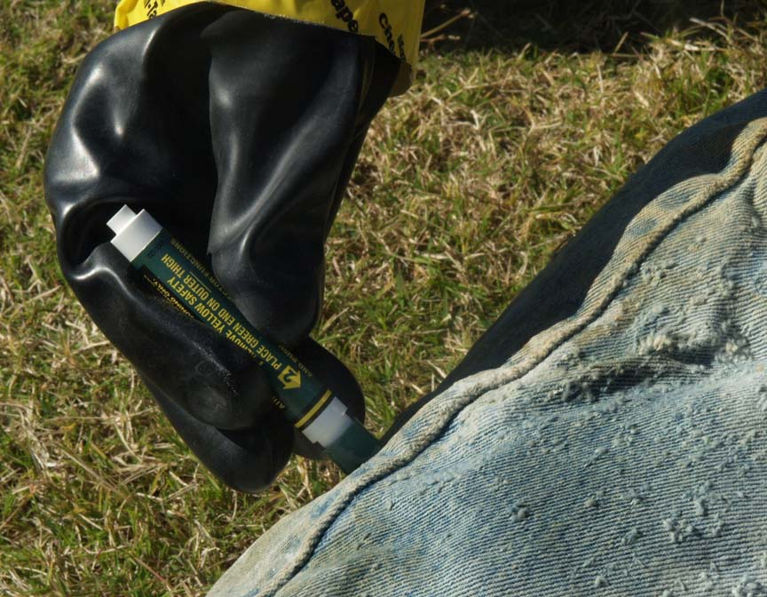
Directions for Using
Auto-Injectors Mark I kit
2-PAM
Atropin
The dose (2 mg) of atropine available in auto injector is not adequate for the moderate to severe exposure to nerve agents
Notes:
There are 7 steps to follow in using auto-injectors in the Mark I Kit to administer antidote to a patient.
The first step is to remove the Mark I Kit from its protective pouch. Grasp the plastic holder exposed at the open end of the pouch and pull the kit out.

Slide 20
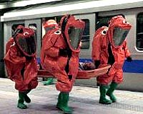
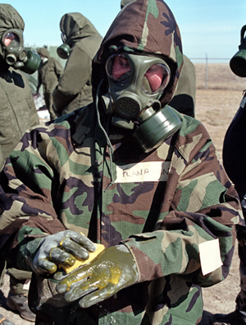
Treatment
Priorities:
protect themselves from contamination:
personal protective equipment
or by thoroughly decontaminating the patient.
rescuers should wear :
a protective mask (or mask containing a charcoal filter for a SCBA device, not a surgical or similar mask)
heavy rubber gloves (surgical gloves offer negligible protection)
Avoid skin contact with victims until decontamination has been carried out
Notes:
The first rule for managing chemical
casualties is that the emergency responders must protect themselves from contamination resulting from contact with casualties and the environment. This can be done by approximate personal protective equipment or by thoroughly decontaminating the patient. At minimum, rescuers should wear a protective mask (or mask containing a charcoal filter for a SCBA device, not a surgical or similar mask) and heavy rubber gloves (surgical gloves offer negligible protection) and avoid skin contact with victims until decontamination has been carried out

Slide 21
Treatment
Decontamination
Vapors can be trapped in clothes and therefore removal of all clothes
Clothing releases G agents for about 30 minutes after contact with vapor

Slide 22
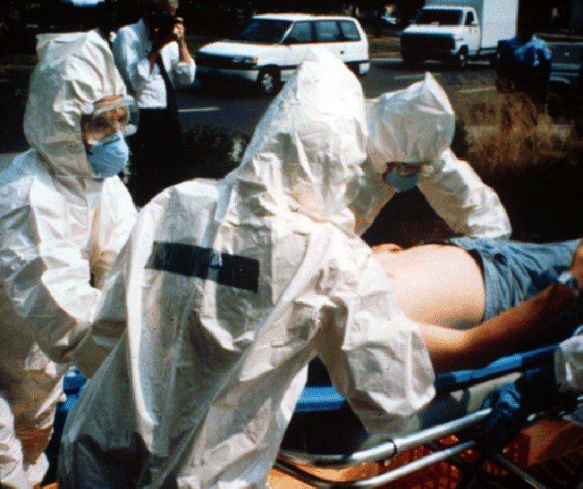
Treatment
Decontamination
Skin decontamination :
large amounts of a chlorine-liberated solution such as 5.0% hypochlorite solution (household bleach) followed by copious water rinsing.(alkaline PH)
alkaline soap and water followed by a water rinse. (gently & without rubbing)
Generous amounts of water alone
Care should be taken to clear under the nails, intertriginous areas, axillae, groin, and hair
Notes:
Skin decontamination should be done by pouring on large amounts of a chlorine-liberated solution such as 5.0% hypochlorite solution (household bleach) followed by copious water rinsing. If bleach is not available, the skin should be blotted gently (without rubbing) with generous amounts of alkaline soap and water followed by a water rinse. Generous amounts of water alone can be used if nothing else is available; water will dilute and physically wash away the agent, but it will not hydrolyze
While decontamination preparations such as fresh hypochlorite react rapidly with some agents (e.g., the half time for destruction of VX by hypochlorite at a pH of 10 is 1.5 minutes), the half times of destruction of other agents, such as mustard, are much longer. If a large amount of agent is present initially, a longer time is needed to completely neutralize the agent to a harmless substance.

Slide 23
Treatment
Decontamination
Skin decontamination :
Hypochlorite solutions are for use on skin and soft tissue wounds only.
Hypochlorite should not be used in
Abdominal wounds
Open chest wounds
On nervous tissue
In the eye
Surgical irrigation solutions should be used in liberal amounts in the abdomen and chest.

Slide 24
Treatment
WOUND DECONTAMINATION
bandages are removed
the wounds are flushed
the bandages are replaced only if bleeding recurs
Tourniquets are replaced with clean tourniquets and the sites of the original tourniquets decontaminated

Slide 25
Treatment
WOUND DECONTAMINATION
Although nerve agents cause their toxic effects by their very rapid attachment to the enzyme acetylcholinesterase, they also quickly react with other enzymes and tissue components.
The blood and necrotic tissue of the wound will "buffer" nerve agents.
Nerve agent that reaches viable tissue will be rapidly absorbed, and since the toxicity of nerve agents is quite high (a lethal amount is a small drop), it is unlikely that casualties who have had much nerve agent in a wound will survive to reach medical care.

Slide 26
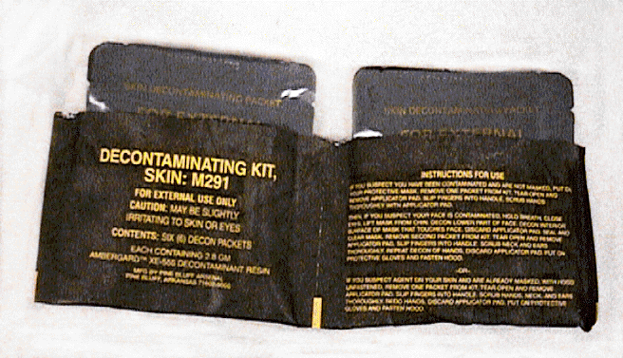
Treatment
Decontamination
A skin decontamination kit approved by FDA containing activated charcoal impregnated with ion exchange resins (Ambergard™ XE-555 ) is also available

Slide 27
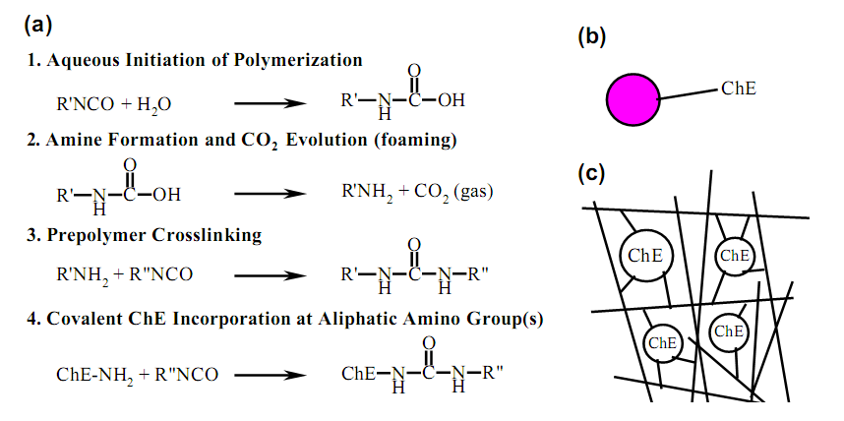
Treatment
Decontamination
Cholinesterase were covalently linked to a polyurethane matrix can effectively be used to remove and decontaminate nerve agents from surface biological (skin or wounds) or otherwise (clothing or medical equipments) or the environment.

Slide 28
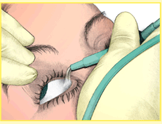
Treatment
Decontamination
If the eyes have been exposed, they should be irrigated as soon as possible with running water or saline.
In cases of ingestion, do not induce emesis. If the victim is alert and able to swallow, immediately administer a slurry of activated charcoal.
Notes:
Thorough decontamination is essential before casualties enter an emergency department or other site of medical care to avoid contamination of staff and other patients.

Slide 29
Treatment
ABC:
Oxygen administration and assisted ventilation should be undertaken as soon as possible in those with respiratory distress.
Airway resistance may be very high initially, causing some mechanical ventilators to malfunction, but it will return toward normal after atropine administration.
Supplemental oxygen through an endotracheal tube with positive end-expiratory pressure is indicated for severely hypoxic patients.
It is important to improve tissue oxygenation before atropine administration to minimize he risk of ventricular fibrillation
Frequent airway suctioning may be required for copious bronchial secretions.

Slide 30
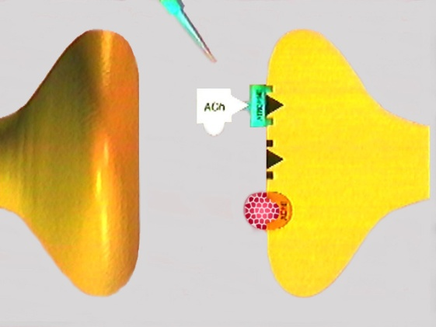
Treatment
Antidotes:
Atropine
Titrated with the goal of the therapy being drying secretions and resolution of bronchoconstriction and bradycardia
In fact, atropine should be given intravenously in doses to produce mild to moderate atropinisation :
dryness of tongue, ropharyngeal and bronchial tree
Tachycardia
Mydriasis

Slide 31
Treatment
Atropine
At least the same amount as the initial atropinisation dose should be infused in 500 dextrose 5% constantly to sustain the atropinisation and repeat it as needed until the patient becomes asymptomatic.
Based on clinical experience of the prof. Balalimood, much lower atropine doses are required for nerve agents than for the severe OP-pesticides poisoning

Slide 32
Treatment
Atropine
Intratracheally atropine →hypotensive
Studies suggest that in addition to the local effects in the lungs, it is also absorbed systemically
Continuous infusion of atropine effectively antagonizes the muscarinic effects and some of the central nervous system effects of nerve agent poisoning, but has no effect on skeletal muscle weakness, seizures, unconsciousness or respiratory failure
Notes:
If the patient is hypotensive, atropine can be given through an endotracheal tube or intratracheally for more rapid absorption through the peribronchial vessels
Aerosolized atropine has also been used and can be administered quickly by inhalation. Studies suggest that in addition to the local effects in the lungs, it is also absorbed systemically (33)

Slide 33
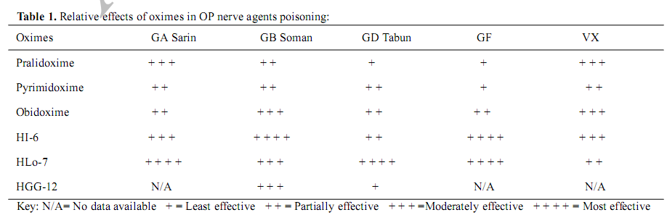
Treatment
Oximes
The choice of oximes presently based on :
Protection against lethality
Cost
Availability
Side effects ( Obidoxime = more toxic )
HLo7>HI6>obidoxime>pralidoxime
Notes:
. HI-6 is the least toxic, but is less unstable in solution and is not commercially available in many parts of the world.

Slide 34
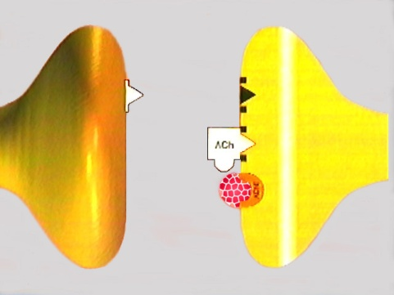
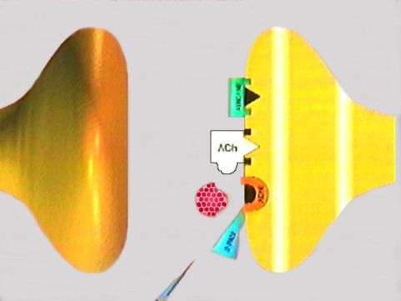
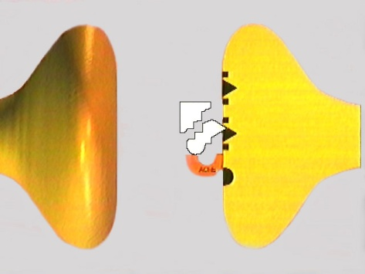
Treatment
Oximes
Pralidoxime should be administered intravenously at a dose of 30mg/kg initially over 30 minutes followed by constant infusion of 8 mg/kg/hr in dextrose 5%.
It could be continued until the full recovery or until atropine is required.
Obidoxime → 500mg initially and about 750 mg-1000mg per day
Liver function tests should be checked regularly during obidoxime therapy
Notes:
. Obidoxime was hepatotoxic at high recommended doses of 8 mg/kg initially and 3 mg/kg/hr (43). It may be given at a dose not more than 500mg initially and about 750 mg1000mg per day. Liver function tests should be checked regularly during obidoxime therapy

Slide 35
Treatment
Diazepam
Anticonvulsant
Cholinergic
GABAergic
Midazolam is the fastest acting and most effective
Notes:
Despite the introduction of diazepam as a symptomatic anticonvulsant, a number of studies have been performed which indicate that the effects of diazepam may be more specific. These studies have mainly investigated the effects on cholinergic and GABAergic systems.

Slide 36
Treatment
New Additional Medications

Slide 37
Treatment
Gacyclidine
Magnesium sulphate
Sodium bicarbonate
Antioxidants

Slide 38
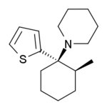
Treatment
Gacyclidine
Gacyclidine (GK-11) is a new phencyclidine derivative with neuroprotective properties which acts as a dissociative via functioning as a
non-competitive NMDA receptor antagonist
(an anti-glutamatergic )

Slide 39
Treatment
Gacyclidine
prevents the mortality
prevented soman induced seizures and motor convulsions.
Accelerated clinical recovery of soman
Prevented the neuropathology observed three weeks after soman exposure in animals
reduction of lesion size and improvement of functional parameters after injury

Slide 40
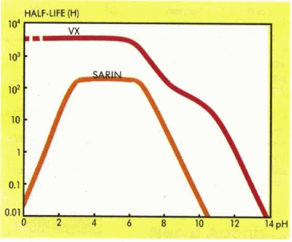
Treatment
Sodium bicarbonate
Effects of sodium bicarbonate in OP pesticide poisoning were investigated in patients with moderate to severe intoxication
Since alkalinisation products of nerve agents (particularly soman) are less toxic, it seems that administration of IV infusion of sodium bicarbonate to produce moderate alkalinisation, may be even more effective in nerve agent poisoning

Slide 41
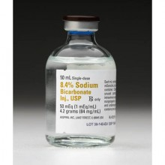
Treatment
Sodium bicarbonate
It was aimed to make an alkalinisation to reach and sustain the arterial blood pH between 7.45 and 7.55.
Sodium bicarbonate was administered I.V. firstly to correct the metabolic acidosis and then 3-5 mg/kg/24h as constant infusion until recovery or until atropine was required

Slide 42
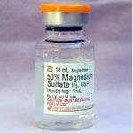
Treatment
Magnesium sulphate
Intravenous magnesium sulfate in a dose of 4 g only on the ﬁrst day after admission reduced hospitalization days and mortality in 8 patients with acute OP poisoning

Slide 43
Treatment
Antioxidants
The toxicity of OP compounds is mediated by generation of nitric oxide and other free radicals.
These toxic molecules can be counteracted by antioxidants such as vitamins C and E, spin traps, melatonin and low molecule weight thiols.
the low molecule weight thiols can also increase the synthesis of glutathione, which can both ameliorate the OP-induced oxidative stress and enhance OP detoxiﬁcation

Slide 44
Pretreatment
reversible acetylcholinestrase inhibitors : such as pyridostigmine and physostigmine, enhances the efficacy of post-exposure treatment of soman exposure or soman poisoning with atropine and pralidoxime chloride and permits survival at higher agent challenges.
pyridostigmine is the drug of choice for pretreatment
approved by the FDA, for wartime use
US military
30 mg orally every eight hours
This protection apparently is due to the fact that the more lethal nerve agents cannot attack acetylcholinestrase molecules bound by carbamates.
Notes:
In animal studies, pre-treatment with reversible
carbamate acetylcholinestrase inhibitors, such as pyridostigmine and physostigmine, enhances the
efficacy of post-exposure treatment of soman exposure or soman poisoning with atropine and pralidoxime chloride and permits survival at higher agent challenges. This protection apparently is due to the fact that the more lethal nerve agents cannot attack acetylcholinestrase molecules bound by carbamates. Carbamylation of 20% to 40% of the erythrocyte ChE is associated with antidotal enhancement. Carbamate pre-treatment will not reduce the effects of the agents, and by themselves carbamates provide no benefit. Pretreatment is not effective against sarin and VX challenge and should not be considered a panacea for all nerve agents. It is of value for soman intoxication when agent challenge is followed by atropine and an oxime. Pretreatment is ineffective unless standard therapy is administered after the exposure.

Slide 45
Pretreatment
Pretreatment is not effective against sarin and VX challenge
Pretreatment is ineffective unless standard therapy is administered after the exposure.
Carbamates must never be used after nerve agent exposure
Notes:
In animal studies, pre-treatment with reversible
carbamate acetylcholinestrase inhibitors, such as pyridostigmine and physostigmine, enhances the
efficacy of post-exposure treatment of soman exposure or soman poisoning with atropine and pralidoxime chloride and permits survival at higher agent challenges. This protection apparently is due to the fact that the more lethal nerve agents cannot attack acetylcholinestrase molecules bound by carbamates. Carbamylation of 20% to 40% of the erythrocyte ChE is associated with antidotal enhancement. Carbamate pre-treatment will not reduce the effects of the agents, and by themselves carbamates provide no benefit. Pretreatment is not effective against sarin and VX challenge and should not be considered a panacea for all nerve agents. It is of value for soman intoxication when agent challenge is followed by atropine and an oxime. Pretreatment is ineffective unless standard therapy is administered after the exposure.

Slide 46
Conclusion
Sodium bicarbonate, Magnesium sulfate and the antioxidants should be added to the standard treatment of OP poisonings.

Slide 47
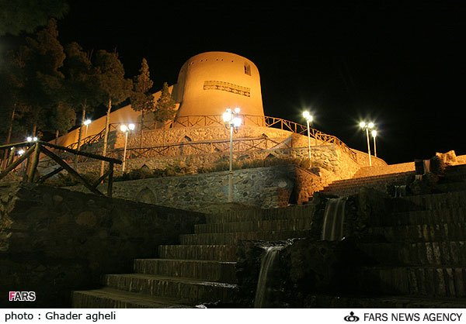
Thanks’ for your attention

